Slide 1

Enhanced predictive learning approaches for Personalized Diet Recommendation System in Healthcare Tech Tycoons : Major Project - 2020

Slide 2
Introduction
Wide variety of ingredients, cultures and personal tastes makes decision about what to eat a great problem.
Many diseases that were previously thought as hereditary are now seen to be connected to biological disfunction related to nutrition.

Slide 3
Cont….
Being healthy and eating better is something the vast majority of the population wants and doing so usually requires great effort.
The working prototype accomplishes a Personalized Diet Recommendation System with integration of Machine Learning Algorithms to recommend the right food at right time and with the right nutrition, calories, fat etc.

Slide 4
Objective
To establish working prototype of a Personalized Diet Recommendation System.

Slide 5
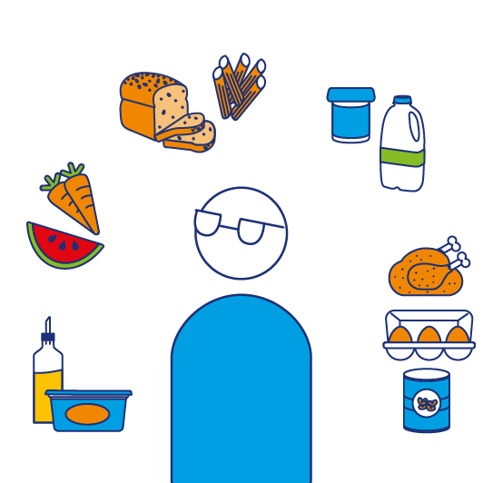
Existing System
The existing working model of the Diet Recommendation System gives recommendations concerning food based on user inputs in general life style on regular food timings.

Slide 6
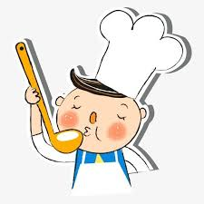
Cont….
The food is recommended based on the user habits of food intake at a particular term according to his/her tastes.

Slide 7
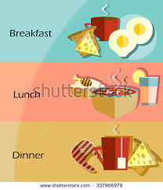
Issues
The issues that are being faced by the current working model is it does not facilitate a user with the food classification based on the food timings on a daily basis other than general food timings.

Slide 8
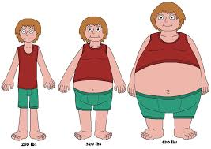
Cont….
The existing system struggles to provide a weight gain/loss scheme to a user based on his long term food habits.

Slide 9
Literature Survey
FUZZY BASED APPROACH FOR DIET PREDICTION
Aarushi Singh, Nandini Kashyap, Rakesh Garg
2019
PAPER - 1
In this paper, the author has proposed a method for finding the optimal method for suggesting diet methods to the various persons belonging to different age groups. Fuzzy Logic (mixture of many logic) helps in determining the balanced diet for each age group. Data was collected from books and websites, which was then trained using fuzzy logic using parameters such as age group, nutrition and food. It was concluded that the diet recommended by Fuzzy concept is more accurate then the diet recommended by the dietician. The diet taken by children is 34.5% and for old aged people it is not more than 50%.
RECOMMENDATION OF DIET TO A PATIENT USING AHP AND FUZZY APPROACH
Sakshi Singh, Sanjay Kumar Dubey
2019
PAPER -2
In this paper, the author suggests a diet recommendation system to cater the needs of a people who are suffering from Marasmus (a person depleted of its stored glycogen and fats) and then to suggest a best diet plan which should be followed for a finest result. We are employing AHP – Analytical Hierarchy Process which helps in determining the balanced diet which has all the vital nutrients in the correct proportions. The result is validated using Fuzzy Logic.

Slide 10
Cont….
PERSONALIZED EXPERT RECOMMENDATION SYSTEM FOR OPTIMAL NUTRITION
Chih-Han Chen, Maria Karvela, Mohammadreza Sohbati, Thaksin Shinawatra, Christofer Toumazou
2018
PAPER - 3
In order to provide meaningful and straight-forward solutions, a novel expert system is proposed in this paper, which aims to personalize grocery shopping through product suggestions based on genetic phenotype. The algorithms used cover the tasks of data categorisation , data analysis and decision recommendation. Deep Neural Network is applied for data categorisation and Genetic algorithm is used for decision recommendation. The system architecture was such developed that it would accept new product information including the nutritional values. The block was then trained with the new values and receives updates from state machine block and stores the trained data. During training , food products are classified into different categories. The block setups threshold for nutrition using genetic algorithm. Ultimately , the decision system would recommend a suggestion of products based on phenotype of personal data, the categories of products and nutritional values.
RECOMMENDATION SYSTEM OF DIETARY PATTERNS FOR CARDIOVASCULAR DISEASE PATIENTS USING DECISION MAKING APPROACH
Garima Rai, Sanjay Kumar Dubey
2019
PAPER -4
In this paper, the author has taken a real dataset and implemented AHP (Analytic Hierarchy Process) and Fuzzy Approach which uses rank based ordering of the results to prepare a Diet Pattern for the patients who are suffering from Cardio Vascular Disease (CVD).The diet consist of food items to be taken up at breakfast, lunch and dinner by CVD patients. The AHP works on the basis of various factors like Consistency Index, Consistency Ratio and Reliability Index. The best diet plan analysis is done taking into consideration the normalization factor for normalizing each value. Now the Fuzzy Logic comes into play to describe the order of ranking so as to which diet plan is suitable.

Slide 11
Cont….
FOOD RECOMMENDATION USING MACHINE LEARNING FOR CHRONIC KIDNEY DISEASE PATIENTS
Anonnya Banerjee, Alaa Noor, Nasrin Siddiqua, Mohammed Nazim Uddin
2019
PAPER - 5
In this work, the authors have proposed a system which is used to predict the actual number of CKD patients using machine learning techniques and after evaluating the accuracy, a query is used to provide a list of recommended food based on the seriousness of the disease. Diverse data mining techniques have been executed on a dataset containing data about patients' determination for CKD. These methods are – Naïve Bayes, Support Vector Machine, and Random Forest. But the core centre is around blood potassium level to distinguish the reasonable eating routine arrangement for a CKD patient. Then the food is recommended for patients suffering from kidney disease. Also food is recommended for the identified levels based on the seriousness of the disease.
PERSONALIZED NUTRITION SOLUTION BASED ON NUTRIGENOMICS
Jitao Yang
2019
PAPER - 6
The DNA algorithm used for recommendation of food using SNP analysis has found to be more effective than traditional and general guidelines. Nutrigenomics is the research about the impact of dietary components on the DNA .Nutrigenomics has helped in designing personalized approach for diet recommendation and diet recommendation. The research of nutrigenomics could not have been so fruitful without the fast develpoment of high-throughput sequencing technologies / chips, which currently can identify more than 700,000 SNPs per individual. The main problem which persisted while suggesting generalized diet was not effective and did not met nutritional needs.

Slide 12
Cont….
a recommender system for adaptive diet monitoring and personalized food suggestion
Agapito G., Calabrese B., Guzzi P. H., Cannataro M., Simeoni M., Car´e I., Lamprinoudi T., Fuiano G., Pujia A.
2017
PAPER - 7
This paper talks about a recommender system which analyses the health profiles of the user and depending upon that provide individualized nutritional recommendation. The proﬁle is created through the use of dynamic real-time questionnaires prepared by medical doctors and compiled by the users. The system provides the adaptive delivery of nutrition contents to improve the quality of life of both healthy people and individuals affected by chronic diet-related diseases. The paper provides a plan to introduce a set of functionalities that make easier for the specialists to add new typical foods or recipes as well as to follow the users’ progress and communicate with them. Thus, it will be possible to increase the interaction among users and medical doctors, providing a richer use experience. Finally, by adding new questionnaires able to proﬁle new diseases as well as new speciﬁc conditions such as pregnancy, athlete and so on, it will be possible to advise more users with recipes and foods suitable for their health status.
A Smart Food Recommendation System
Sajjad Madani, Nuhman Haq, Osman Khalid, Faisal Rehman
2017
PAPER - 8
Inadequate and inappropriate intake of food is known to cause various health issues and diseases. Due to diversity in food components and large number of dietary sources, it is challenging to perform real-time selection of diet patterns that must fulfil one’s nutrition needs. A cloud based module is created. The model uses ant colony algorithm to generate optimal food list and recommends suitable foods according to the values of pathological reports. Diet-Right can play a vital role in controlling various diseases. The experimental results show that compared to single node execution, the convergence time of parallel execution on cloud is approximately 12 times lower. Moreover, adequate accuracy is attainable by increasing the number of ants.

Slide 13
Cont….
HEALTHY DIET recommendation system USING WEB DATA MINING
Rushali J. Watane , Nitin R.Chopde
2014
PAPER - 9
In this busy scheduled life, People usually don’t care about their health. It makes the person follow unhealthy food habits in the name of saving time. So it has become very essential for the people to have a good balanced healthy diet. The process uses Substance Based Filtering using Decision Trees and predicts the desired result.
recommender systems in the healthy food domain
Martin Stettinger, Alexander Felfernig
2017
PAPER - 10
Recently, food recommender systems have received increasing attention due to their relevance for healthy living. These systems also provide functionalities to keep track of nutritional consumption as well as to persuade users to change their eating behavior in positive ways. Also, group recommendation functionalities are very useful in the food domain, especially when a group of users wants to have a dinner together at home or have a birthday party in a restaurant. Such scenarios create many challenges for food recommender systems since the preferences of all group members have to be taken into account in an adequate fashion. In this paper, we present an overview of recommendation techniques for individuals and groups in the healthy food domain. The process uses collaborative filtering and content based filtering techniques to execute the process.

Slide 14
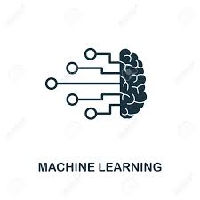



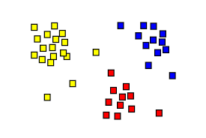
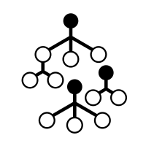
System Architecture
PYTHON
DATASET
LUNCH
BREAKFAST
DINNER
K-MEANS CLUSTERING
RANDOM FOREST CLASSIFIER

Slide 15
System Workflow
DATASET
CLUSTERING – K-Means
CLASSIFICATION - RANDOM FOREST CLASSIFIER
DIET RECOMMENDATIONS
USER ITERFACE
.

Slide 16

Modules
DATASET
- ABHISHEK VERMA AND UDIT SAVLA
DATASET – Type of food with all nutritional values

Slide 17
Cont….
MACHINE LEARNING MODEL:
DATA CLASSIFICATION
- MOHNISH RAVAL AND TANYA OJHA
RANDOM FORETS CLASSIFICATION

Slide 18
Cont….
CLUSTERING
- ABHISHEK VERMA AND UDIT SAVLA
K-MEANS CLUSTERING

Slide 19
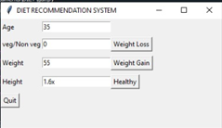
Cont….
GUI – PYTHON (using TKINTER)
- MOHNISH RAVAL AND ABHISHEK VERMA
GUI

Slide 20
Cont….
TECH STACK AND TOOLS USED
- TEAM TECH TYCOONS

Slide 21
Implementation Procedure
For training of the system , the initial process involves the segregation of food items depending upon the meal for which they are consumed i.e Breakfast , Lunch and Dinner.
The clustering of various nutrients depending upon which are essential for the weightloss , weightgain and healthy is performed.
After the clustering is performed , using Random Forest classifier , the nearest food items are predicted which best suites for the appropriate diet.

Slide 22
Cont….
As part of user interface , the inputs needed from the user are Age , Height , Weight and what the purpose for which the diet is required.
Depending upon it , from the appropriate clustering , specific food items are classified and recommended to the user.

Slide 23
Tech Stack and Tools
Python 3.4
Spyder 3

Slide 24
Code:
Breakfastdata=data['Breakfast']
BreakfastdataNumpy=Breakfastdata.to_numpy()
Lunchdata=data['Lunch']
LunchdataNumpy=Lunchdata.to_numpy()
Dinnerdata=data['Dinner']
DinnerdataNumpy=Dinnerdata.to_numpy()
Food_itemsdata=data['Food_items']
breakfastfoodseparated=[]
Lunchfoodseparated=[]
Dinnerfoodseparated=[]
breakfastfoodseparatedID=[]
LunchfoodseparatedID=[]
DinnerfoodseparatedID=[]
for i in range(len(Breakfastdata)):
if BreakfastdataNumpy[i]==1:
breakfastfoodseparated.append(Food_itemsdata[i])
breakfastfoodseparatedID.append(i)

Slide 25
Cont….
for i in range(len(Breakfastdata)):
if BreakfastdataNumpy[i]==1:
breakfastfoodseparated.append(Food_itemsdata[i])
breakfastfoodseparatedID.append(i)
if LunchdataNumpy[i]==1:
Lunchfoodseparated.append(Food_itemsdata[i])
LunchfoodseparatedID.append(i)
if DinnerdataNumpy[i]==1:
Dinnerfoodseparated.append(Food_itemsdata[i])
DinnerfoodseparatedID.append(i)
#print ('BREAKFAST FOOD ITEMS')
#print (breakfastfoodseparated)
#print ('LUNCH FOOD ITEMS')
#print (Lunchfoodseparated)
#print ('DINNER FOOD ITEMS')
#print (Dinnerfoodseparated)

Slide 26
Cont….
# retrieving rows by loc method |
LunchfoodseparatedIDdata = data.iloc[LunchfoodseparatedID]
print(LunchfoodseparatedID)
LunchfoodseparatedIDdata=LunchfoodseparatedIDdata.T
val=list(np.arange(5,15))
Valapnd=[0]+val
LunchfoodseparatedIDdata=LunchfoodseparatedIDdata.iloc[Valapnd]
LunchfoodseparatedIDdata=LunchfoodseparatedIDdata.T
#print (LunchfoodseparatedIDdata)
# retrieving rows by loc method
breakfastfoodseparatedIDdata = data.iloc[breakfastfoodseparatedID]
breakfastfoodseparatedIDdata=breakfastfoodseparatedIDdata.T
val=list(np.arange(5,15))
Valapnd=[0]+val
breakfastfoodseparatedIDdata=breakfastfoodseparatedIDdata.iloc[Valapnd]
breakfastfoodseparatedIDdata=breakfastfoodseparatedIDdata.T
#print (breakfastfoodseparatedIDdata)

Slide 27
Cont….
age=int(e1.get())
veg=float(e2.get())
weight=float(e3.get())
height=float(e4.get())
bmi = weight/(height**2)
agewiseinp=0
for lp in range (0,80,20):
test_list=np.arange(lp,lp+20)
for i in test_list:
if(i == age):
print('age is between',str(lp),str(lp+10))
tr=round(lp/20)
agecl=round(lp/20)

Slide 28
Cont….
#conditions
print("Your body mass index is: ", bmi)
if ( bmi < 16):
print("severely underweight")
clbmi=4
elif ( bmi >= 16 and bmi < 18.5):
print("underweight")
clbmi=3
elif ( bmi >= 18.5 and bmi < 25):
print("Healthy")
clbmi=2
elif ( bmi >= 25 and bmi < 30):
print("overweight")
clbmi=1
elif ( bmi >=30):
print("severely overweight")
clbmi=0

Slide 29
CONT…
import matplotlib.pyplot as plt
Datacalorie=LunchfoodseparatedIDdata[1:,1:len(LunchfoodseparatedIDdata)]
#print(Datacalorie)
X = np.array(Datacalorie)
kmeans = KMeans(n_clusters=3, random_state=0).fit(X)
print ('## Prediction Result ##')
print(kmeans.labels_)
XValu=np.arange(0,len(kmeans.labels_))
# fig,axs=plt.subplots(1,1,figsize=(15,5))
# plt.bar(XValu,kmeans.labels_)
lnchlbl=kmeans.labels_
# plt.title("Predicted Low-High Weigted Calorie Foods")

Slide 30
Result
A working prototype of a Diet Recommendation System is established.
The module works on the basis of K-Means Clustering and Random Forest Classification Algorithms.
Tkinter based GUI is implemented.

Slide 31
Cont….
Working GUI

Slide 32
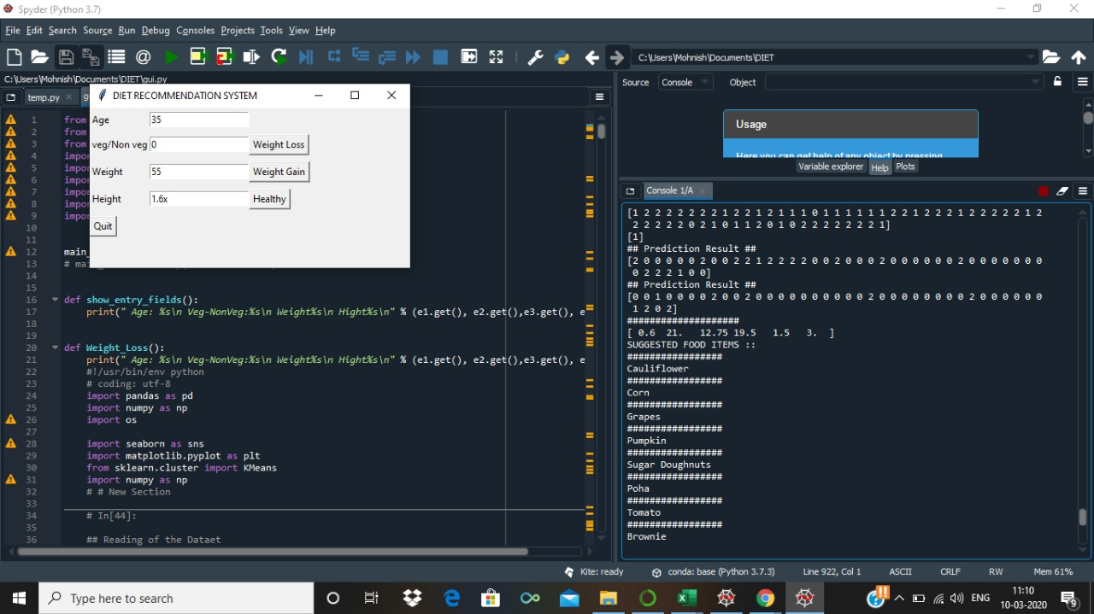
Cont….
Working Module

Slide 33
Cont….
Diet is recommended based on the user’s input and also the desired food list is displayed.
BMI’ is also calculated and taken into consideration.
Weight Loss/Gain/Healthy diet category is also predicted.

Slide 34
Cont….
Future scope:
The module can be implemented as a cloud based application.
Packaged as a single entity, ready for production environment deployment .

Slide 35
Conclusion
A Diet Recommendation System is implemented with the working functionalities like:
Desired food list prediction.
Weight category prediction.
BMI Calculation.
Health is vital for an individual and can be achieved with this working module. Thus making life healthy.

Slide 36
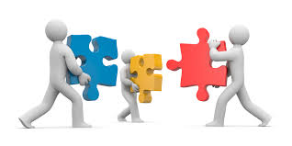
Team : Tech Tycoons
Team Members :
Abhishek Verma - RA1611008010402
Mohnish Raval - RA1611008010453
Tanya Ojha - RA1611008010525
Udit Savla - RA1611008010565
Panel Members :
Nimala K
Saveetha D
Guide :
Nallarasan V

Slide 37

Questions

Slide 38

Thank You

